Slide 1

VENDING MACHINE IN C
BY : ARSALAN ZUBAIR 20K-0215 OSAMA AHMED SIDDIQUI 20K-0216

Slide 2

THE CONTENTS
INPUT CODE+OUTPUT RESULT
SOURCE OF IDEA
ADVANTAGES/DISADVANTAGES

Slide 3
THE INPUT CODE (click to open it on dev c++)

Slide 4
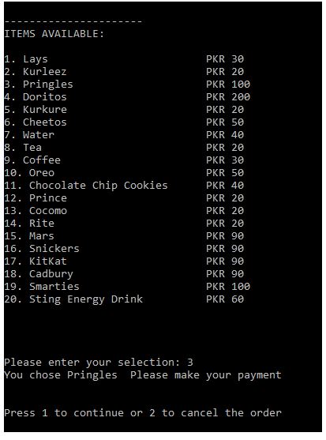
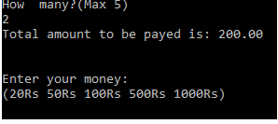
THE OUTPUT RESULT

Slide 5
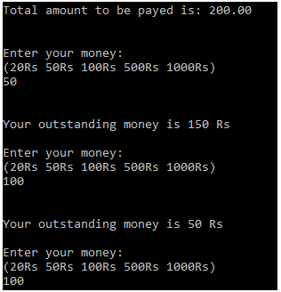
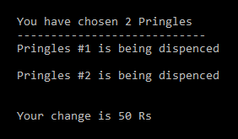
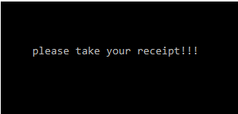
THE OUTPUT RESULT (continued…)

Slide 6
Advantages/disadvantages:
Advantages
Disadvantages
Vending machine is automated, So, you can use it when the transaction is done according to how the machine is programmed
Some Vending machines accept cash in the currency forms only while the others accept both the cash and the credit cards for the electronic transactions.
Vending machines have the mobility, They can be moved to the new places & they will continue delivering the services as usual, There is no cashier, They give the clients the free choice to purchase the products at any time of the day, You can shop for your intended product on a 24 hour, throughout the year.
Vending machines work 24 h day 365 days a year
fixed prices apply and this may be unfriendly both to the customer and the owner.
Fraud cases are common in this kind of business by the customers who formulate means of hacking into the system of the machine to dispense the products
There are great losses to the investor who faces the cases of destruction of the machine or the faulty programming such as the continuous dispensing of product due to the technical errors.
Vending machines are used to be displayed in the public places and they can suffer vandalism by the unruly groups or the jealous competitors

Slide 7
SOURCE OF IDEA
The idea for a vending machine program was taken from the market although some research has done on how it works.
Multiple codes have been added(through research) in order for the machine to run conveniently and smoothly.
This machine also hands over a receipt at the end which shows the idea was totally market based .

Slide 8
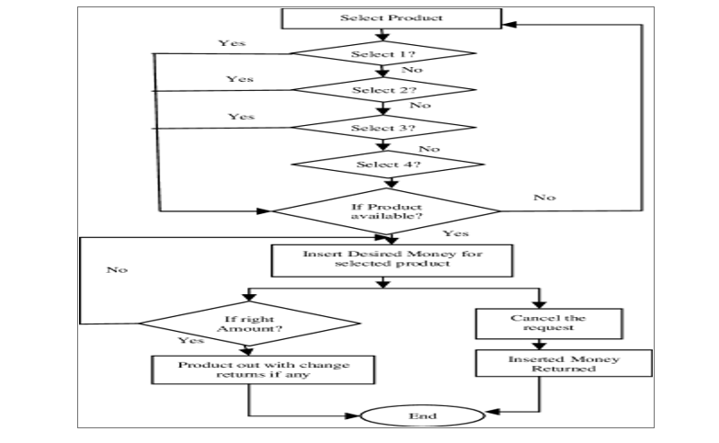

Slide 9

Thank You
K20015@nu.edu.PK
K200216@NU.EDU.PK

